Slide 1
UBL
ARTICLE AND QUANTIFIER
Dr. Hariyadi Raharjo
http://www.free-powerpoint-templates-design.com

Slide 2
Your Lecturer
Dr. Didik Hariyadi Raharjo, M.Pd.
081288111430

Slide 3
Lecture Agenda
01
Opening
In this phase, the lecturer will deliver the learning objectives and check the students' attendance.
02
Lecture and Discussion
In this phase, the lecturer will explain the learning material, give some examples and invite you to discuss the materials.
03
Evaluation
In this phase, the lecturer will check your understanding by giving some instructions and questions.
04
Closing
In this phase, the lecturer will invite you to make conclusions and provide additional explanations.

Slide 4

Are You Ready?
Just prepare yourself.

Slide 5
Welcome!!
To Bahasa Inggris Class
Students are able to use article and quentifier in computer and information technology contexts.

Slide 6

What is article in English?
Articles, quantifiers, and determiners are the little words we use before nouns. When you see the words a, an, and the, you know that a noun will follow them. These words are articles. Words such as each, every, either, neither, much, enough, which, what, some, and any also mark nouns.
Quantifiers come before nouns or noun phrases and tell us how many or how much of something. These words include many, a few, much, a little, plenty, a lot, some, and enough. For example, "There are enough cookies for everyone," and, "I saw a couple of horses in the field."

Slide 7
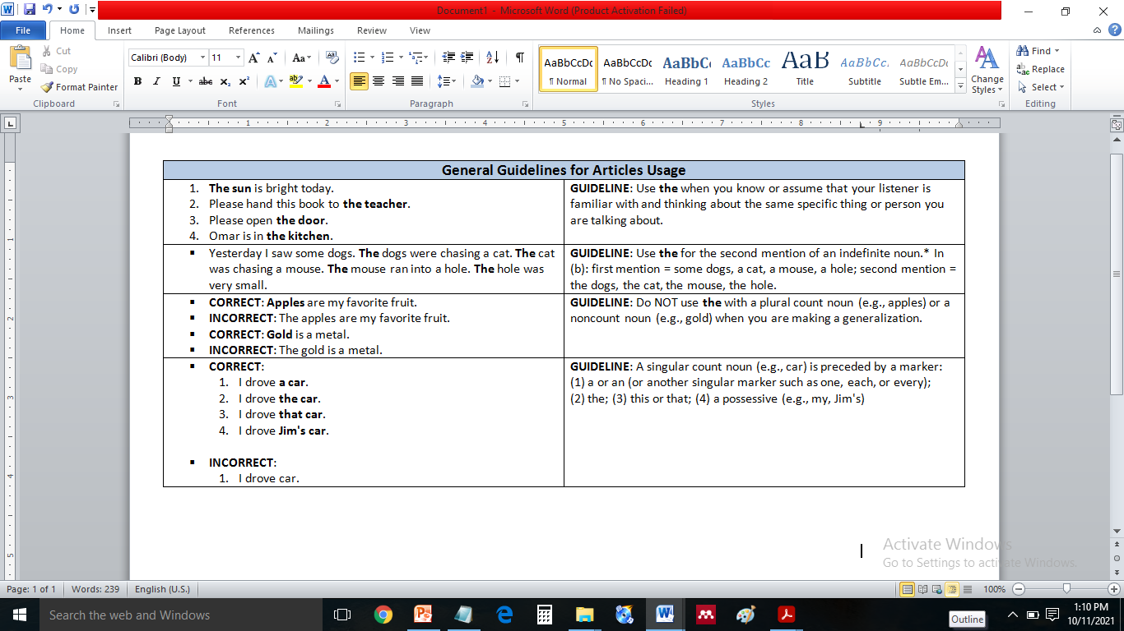
General Guides
Articles

Slide 8
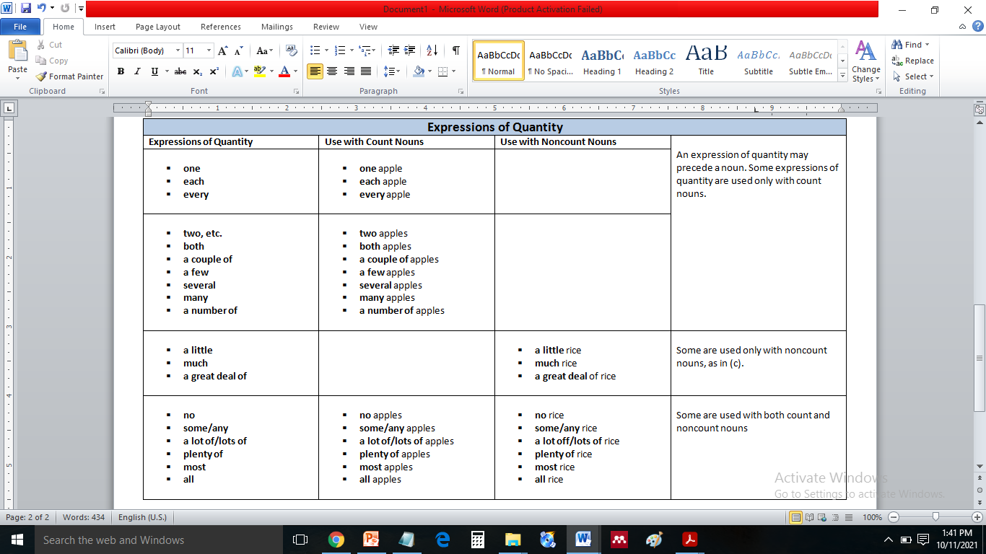
Expression of Quantity
Articles

Slide 9
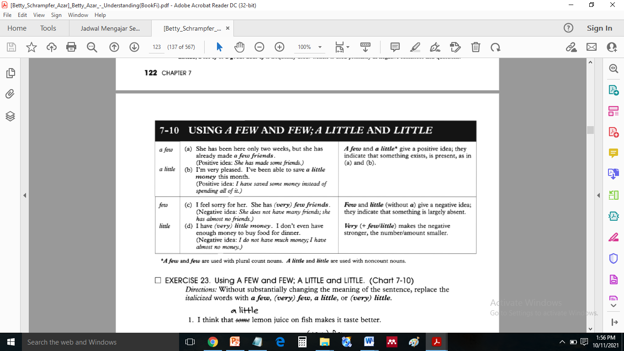
USING
01
02
A FEW AND FEW; A LITTLE AND LITTLE

Slide 10
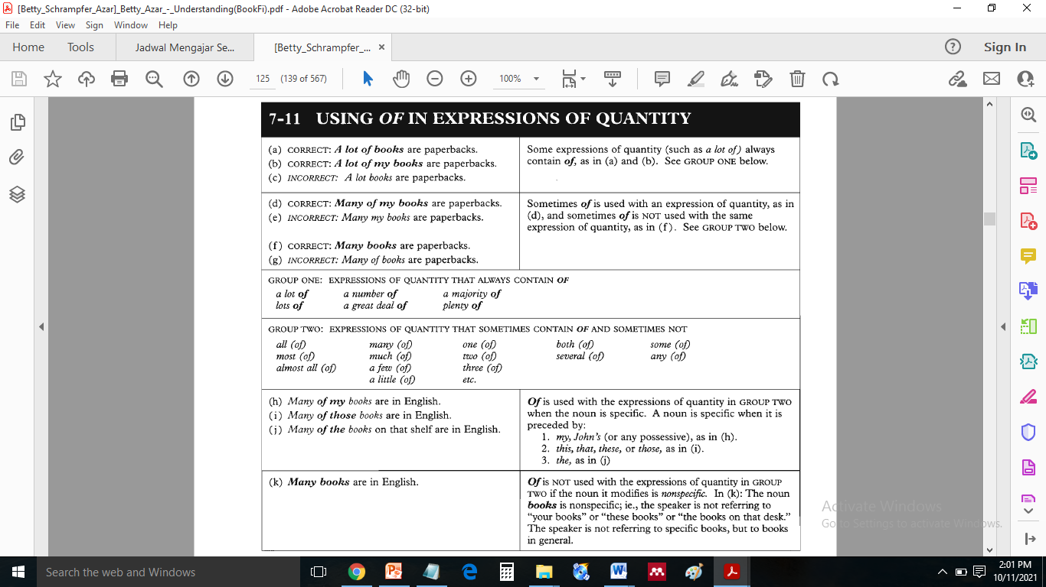
USING
01
02
“OF” IN EXPRESSIONS OF QUANTITY

Slide 11
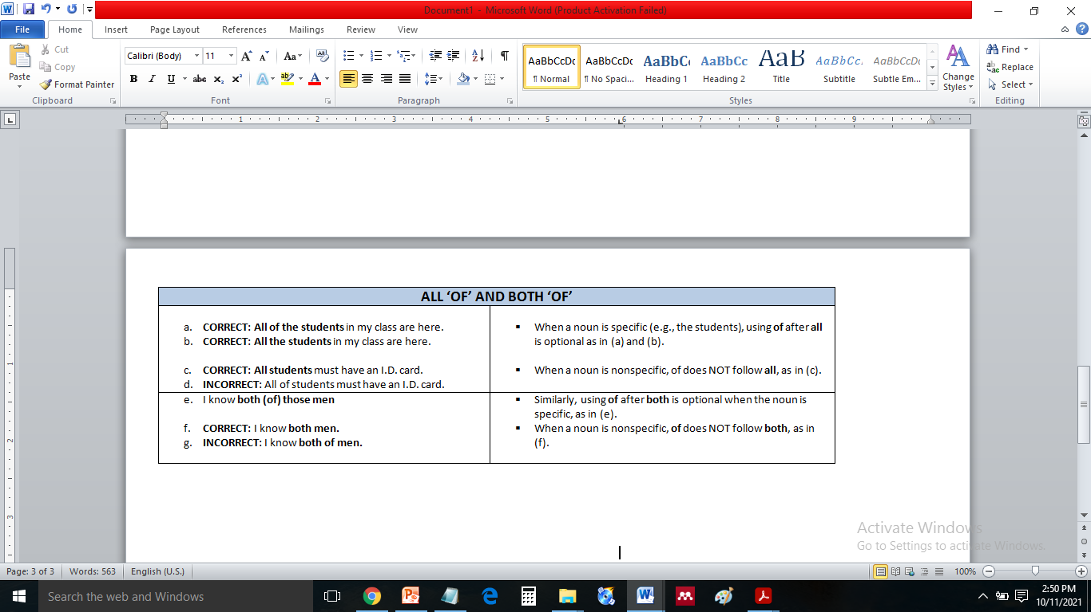
USING
01
02
ALL (OF); BOTH (OF)

Slide 12
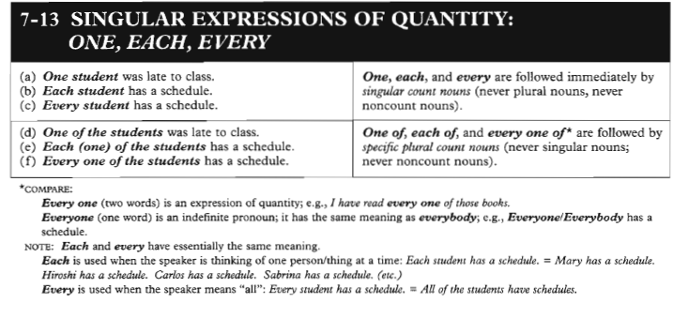
ONE, EACH & EVERY
01
02
SINGULAR EXPRESSION

Slide 13
Do You Understand?
Let’s discusse together!.

Slide 14
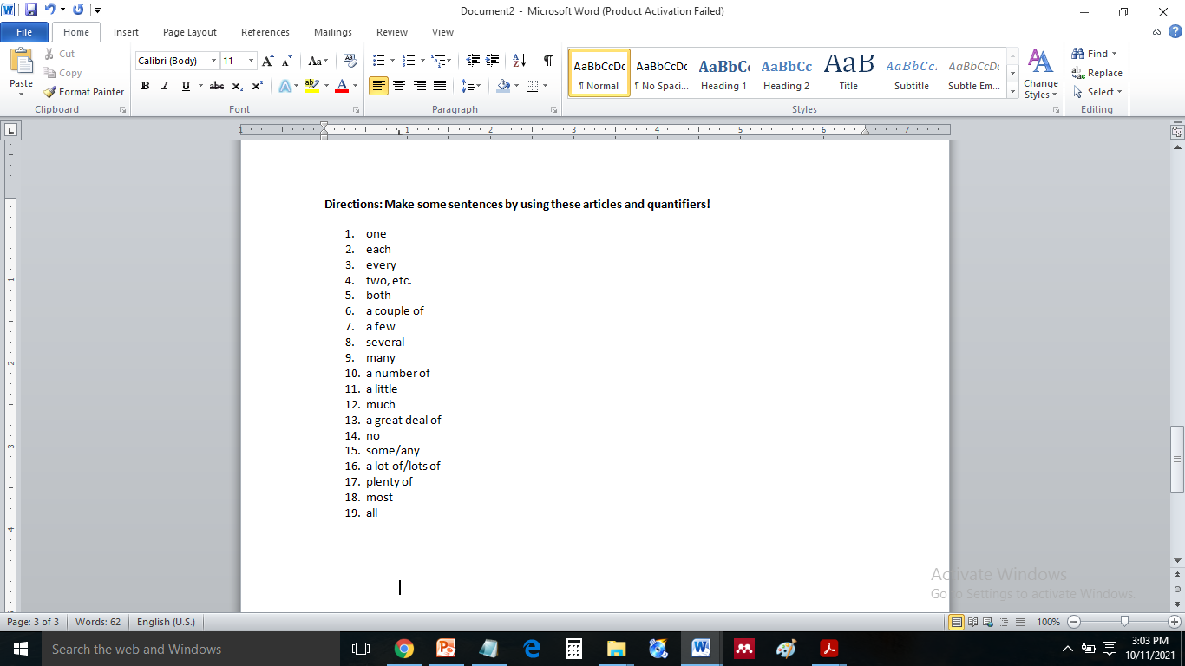
EVALUATION
ARTICLE AND
QUANTIFIER
Directions: Make some sentences by using these articles and quantifiers!

Slide 15
Thank you
Good Luck

